Slide 1
NBA-ALLSTAR
2020-2021
- Members -
Haixiao Lu, Runsheng Zhou, Tengnan Yao
- Instructor -
Charles Nicholson

Slide 2
Executive Summary
The National Basketball Association All-Star Game has been an interesting weekend for all the basketball fans all over the world. This project is based on personal interest to predict the top 12 players from both East and West Conference. It is compared with previously selected NBA All-Star players in the previous seasons. The goal of this project is to understand the impact feature selection had on the overall accuracy of the analysis when comparing different models. This model also will predict which team will win between the West and East Conference Team.
The training dataset used for this project contains 5 seasons data which was from 2015 to 2019. 182812 observations and 90 variables are collected from this dataset. For the purpose of creating a higher performance model, the data was split by each season. To reduce the 90 features, a wrapper feature selection algorithm known as Boruta was used in each dataset to extract the important features. Some of the new features also added to each dataset, such as sum, average and rank all player’s performance in that particular season. Then the entire data set is categorized by each individual player’s name. In addition, the players are also divided into West and East since we are ultimately choosing players from East and West conferences separately. The final training dataset has 202 features for each season dataset. Therefore, there are 10 dataframes(5 seasons times 2 conference teams each) to train the models as training data. The rest of 2 dataframes which is the data from the 2020-2021 season are used to predict the final result.
The modeling process consisted of creating both logistic regression models and decision trees.

Slide 3
TABLE OF CONTENTS
01
02
03
04
Project and Data Understanding
Making friends with our data.
Data Preparation
Massaging our friend.
Modeling
Playing with our friend.
Prediction
He tells us the secret.

Slide 4
Project and Data Understanding
01

Slide 5

30 Teams
The NBA originated in 1946 with 11 teams, and through a sequence of team expansions, reductions, and relocations, currently consists of 30 teams. The United States is home to 29 teams; another is in Canada.

Slide 6

East vs West
The Eastern Conference of the National Basketball Association (NBA) is one of two conferences that makes up the league, the other being the Western Conference. Both conferences are made up of 15 teams organized into three divisions.

Slide 7
Data Glimpse
Player | Team | Opponent | ... | Date | Minute | FGM | FGA | FG. | X3P | X3PA | X3P. | ... | Season
Jrue Holiday | New Orleans Pelicans | Toronto Raptors | ... | 2014-10-28 | 36:32 | 6 | 15 | 0.4 | 1 | 6 | 0.167 | ... | 2015
Brandon Ingram | New Orleans Pelicans | Toronto Raptors | ... | 2014-10-28 | 35:03 | 8 | 19 | 0.43 | 2 | 5 | 0.40 | ... | 2015
J.J. Redick | New Orleans Pelicans | Toronto Raptors | ... | 2014-10-28 | 2:15 | 6 | 9 | 0.67 | 4 | 6 | 0.67 | ... | 2015
Lonzo Ball | New Orleans Pelicans | Toronto Raptors | ... | 2014-10-28 | Did Not Play | NA | NA | NA | NA | NA | NA | ... | 2015
Derrick Favors | New Orleans Pelicans | Toronto Raptors | ... | 2014-10-28 | Did Not Play | NA | NA | NA | NA | NA | NA | ... | 2015
... | ... | ... | ... | ... | ... | ... | ... | ... | ... | ... | ... | ... | ...

Slide 8
NA analysis
Most of our NAs are caused by when a player was not playing in a specific game. And the rest might be caused by not well recorded because they always occur to almost the whole row.

Slide 9
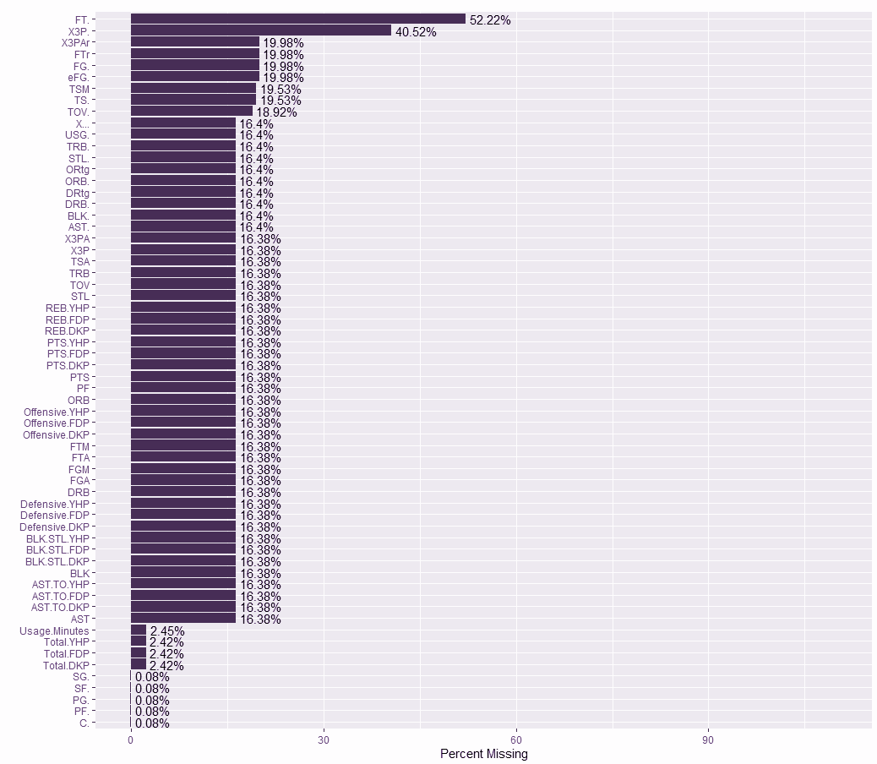
Code Snippets
Visualize NAs
NAcols <- which(colSums(is.na(data)) > 0)
NAcount <- sort(colSums(sapply(data[NAcols], is.na)), decreasing = TRUE)
NADF <- data.frame(variable = names(NAcount), missing = NAcount)
NADF$PectMissing <- round((NADF$missing / nrow(data) * 100), 2)
missingValuePercentage <- NADF %>%
ggplot(aes(x = reorder(variable, PectMissing), y = PectMissing)) +
geom_bar(stat = 'identity', fill = 'red') + coord_flip(y = c(0, 110)) +
labs(x = "", y = "Percent Missing") +
geom_text(aes(label=paste0(PectMissing, '%'), hjust = -0.1))
missingValuePercentage

Slide 10
Data Preparation
02

Slide 11
Massage the data
Separate into 5 seasons
Deal with NAs.
Extract useful predictors
Separate east from west

Slide 12
Code Snippets
Separate into seasons
data2015 <- data[data$Season == 2015, ]
data2016 <- data[data$Season == 2016, ]
data2017 <- data[data$Season == 2017, ]
data2018 <- data[data$Season == 2018, ]
data2019 <- data[data$Season == 2019, ]
data2020 <- data[data$Season == 2020, ]

Slide 13
Code Snippets
Deal with NAs
massage = function(dataFrame) {
# player did not play in a specific game
newData <- dataFrame[dataFrame$Minutes != "Did Not Play", ]
# remove rows that have too many NAs
newData <- newData[rowSums(is.na(newData)) < 10,]
…
}

Slide 14
Code Snippets
Extract useful predictors
cols <- c(
"Player",
"Team",
"FGM", # Field Goals Made
"FGA", # Field Goals Attempt
# "FG.", # Field Goals Percentage
"X3P", # 3-Points
"X3PA", # 3-Points Attempt
# "X3P.", # 3-Points Percentage
"FTM", # Free Throws Made
"FTA", # Free Throws Attempt
# "FT.", # Free Throws Percentage
...
"Double.Double",
"Triple.Double"
)

Slide 15
Code Snippets
Separate West from East
West <- c("Golden State Warriors", "Houston Rockets", "Utah Jazz", "Phoenix Suns",
"Denver Nuggets", "Oklahoma City Thunder", "San Antonio Spurs",
"Dallas Mavericks", "Minnesota Timberwolves", "Los Angeles Lakers",
"Los Angeles Clippers", "Memphis Grizzlies", "Portland Trail Blazers",
"Sacramento Kings", "New Orleans Pelicans")
data2015_West <- cleanData2015[cleanData2015$Team %in% West, ]
data2015_West$Team <- NULL
data2015_East <- cleanData2015[!(cleanData2015$Team %in% West), ]
data2015_East$Team <- NULL

Slide 16
10,0000+ Observations
52 predictors
after massage.
selected.

Slide 17
Transformations
New Feature
Add player selection results in previous seasons as the target variable.
Aggregation
Aggregation sum, average, rank sum and rand average grouped by player.
Separation(done)
Separate 5 seasons, east and west.

Slide 18
Code Snippets
Aggregations
aggregateFunc <- function(data) {
groupedData <- data %>% group_by(Player)
sumData <- groupedData %>% summarise_all(sum)
colnames(sumData) <- paste("sum", colnames(sumData), sep = "_")
names(sumData)[1] <- "Player"
meanData <- groupedData %>% summarise_all(mean)
colnames(meanData) <- paste("mean", colnames(meanData), sep = "_")
sumDataRank <- (-sumData[, -1]) %>% apply(2, rank)
glimpse(sumDataRank)
colnames(sumDataRank) <- paste("rank", colnames(sumDataRank), sep = "_")
meanDataRank <- (-meanData[, -1]) %>% apply(2, rank)
colnames(meanDataRank) <- paste("rank", colnames(meanDataRank), sep = "_")
return (sumData %>%
cbind(meanData[, -1]) %>%
cbind(sumDataRank) %>%
cbind(meanDataRank)
)
}

Slide 19
Code Snippets
Mark the selected players
allstar2015east <- c('John Wall', 'Kyle Lowry', 'LeBron James', 'Pau Gasol',
'Carmelo Anthony', 'Al Horford', 'Chris Bosh', 'Paul Millsap',
'Jimmy Butler', 'Dwyane Wade', 'Jeff Teague', 'Kyrie Irving',
'Kyle Korver')
allstar2015west <- c('Stephen Curry', 'Kobe Bryant', 'Anthony Davis', 'Marc Gasol',
'Blake Griffin', 'LaMarcus Aldridge', 'Tim Duncan',
'Kevin Durant', 'Klay Thompson', 'Russell Westbrook',
'James Harden', 'Chris Paul', 'DeMarcus Cousins',
'Damian Lillard', 'Dirk Nowitzki')
d2015east <- data2015_East_Aggr
d2015east$select <- 0
d2015east$select[d2015east$Player %in% allstar2015east] <- 1
d2015west <- data2015_West_Aggr
d2015west$select <- 0
d2015west$select[d2015west$Player %in% allstar2015west] <- 1

Slide 20
It is ready!
5 x 2
2
10+
Dataframes for modeling
Dataframes for prediction
Models to choose from

Slide 21
Modeling
03

Slide 22
Models
LOGISTIC REGRESSION
Boruta is used for feature selection
RIDGE REGRESSION
Cross validation is used
MARS
CLASSIFICATION TREE(RPART)
DECISION TREE
Repeated cross validation is used
RANDOM FOREST
SUPPORT VECTOR MACHINE

Slide 23
Code Snippets
Logistic model
glmModel <- function (dataset) {
model <- glm(data = dataset,
select ~ sum_FGM + sum_FTM + sum_PTS + sum_PTS.FDP + sum_Total.FDP +
sum_PTS.DKP + sum_Total.DKP + sum_PTS.YHP + sum_Total.YHP +
mean_FGM + mean_FGA + mean_PTS + mean_TSA + mean_PTS.FDP +
mean_Offensive.FDP + mean_Total.FDP + mean_PTS.DKP +
mean_Offensive.DKP + mean_Total.DKP + mean_PTS.YHP +
mean_Offensive.YHP + mean_Total.YHP + rank_sum_FGM +
rank_sum_FTM + rank_sum_PTS + rank_sum_PTS.FDP +
rank_sum_Total.FDP + rank_sum_PTS.DKP + rank_sum_Total.DKP +
rank_sum_PTS.YHP + rank_sum_Total.YHP + rank_mean_FGM +
rank_mean_FGA + rank_mean_PTS + rank_mean_TSA +
rank_mean_PTS.FDP + rank_mean_Offensive.FDP + rank_mean_Total.FDP +
rank_mean_PTS.DKP + rank_mean_Offensive.DKP + rank_mean_Total.DKP +
rank_mean_PTS.YHP + rank_mean_Offensive.YHP + rank_mean_Total.YHP,
family = "binomial")
pred_east <- predict(model, data2020_East_Aggr[ , -1])
pred_west <- predict(model, data2020_West_Aggr[ , -1])
return (list(pred_east, pred_west))
}

Slide 24
Code Snippets
Ridge model
ridgeModel <- function(dataset) {
ctrl <- trainControl (method = "cv", number = 10)
model <- train(select ~ .,
data = dataset[ , -1],
method = "glmnet",
trControl = ctrl,
tuneGrid = data.frame(alpha = 0, lambda = seq(0, 0.5, 0.9)))
pred_east <- predict(model, data2020_East_Aggr[,-1])
pred_west <- predict(model, data2020_West_Aggr[,-1])
return (list(pred_east, pred_west))
}

Slide 25
Code Snippets
MARS model
marsModel <- function(dataset) {
model <- earth(select ~ ., data = dataset[ , -1])
pred_east <- predict(model, data2020_East_Aggr[,-1])
pred_west <- predict(model, data2020_West_Aggr[,-1])
return (list(as.vector(pred_east), as.vector(pred_west)))
}

Slide 26
Code Snippets
Rpart model
rpartModel <- function(dataset) {
model <- rpart(select ~ ., data = dataset[ , -1])
pred_east <- predict(model, data2020_East_Aggr[ , -1])
pred_west <- predict(model, data2020_West_Aggr[ , -1])
return (list(pred_east, pred_west))
}

Slide 27
Code Snippets
Decision tree model
dtModel <- function(dataset) {
ctrl <- trainControl(method = "repeatedcv", number = 5, repeats = 10)
tune <- train(select ~ ., data = dataset, method = "rpart", trControl = ctrl)
model <- rpart(select ~ ., data = dataset[ , -1], cp = tune$bestTune)
pred_east <- predict(model, data2020_East_Aggr[ , -1])
pred_west <- predict(model, data2020_West_Aggr[ , -1])
return (list(pred_east, pred_west))
}

Slide 28
Code Snippets
Random forest model
rfModel <- function(dataset) {
model <- randomForest(select ~ .,
data = dataset[ , -1],
mtry = 4,
ntree = 800,
maxnodes = 25)
pred_east <- predict(model, data2020_East_Aggr[ , -1])
pred_west <- predict(model, data2020_West_Aggr[ , -1])
return (list(pred_east, pred_west))
}

Slide 29
Code Snippets
SVM model
svmModel <- function(dataset) {
model <- svm(select ~ .,
data = dataset[ , -1],
type = "C-classification",
kernel = 'linear',
probability = TRUE)
pred_east <- predict(model, data2020_East_Aggr[ , -1])
pred_west <- predict(model, data2020_West_Aggr[ , -1])
return (list(as.numeric(pred_east), as.numeric(pred_west)))
}

Slide 30
Excellent models!
Before prediction all models have been evaluated and all of them have excellent accuracy which is around 95% or above.

Slide 31
Prediction
04

Slide 32
Who are the highest scored???
Player | glm2015e | ... | ridge2015e | ... | rpart2015e | ... | dt2015e | ... | rf2015e | ... | svm2019w
Abdel Nader | -40.2442649 | ... | -0.0405576101 | ... | 0 | ... | 0 | ... | -1.321946e-16 | ... | 1
Alec Burks | -42.4816484 | ... | 0.052427346 | ... | 0 | ... | 0.1428571 | ... | 9.416667e-03 | ... | 1
Alen Smailagic | -79.0428812 | ... | 0.450261736 | ... | 0 | ... | 0 | ... | -8.425552e-17 | ... | 2
Alex Caruso | 2.9141778 | ... | -0.121859324 | ... | 0 | ... | 1 | ... | 9.375000e-04 | ... | 2
Alex Len | -108.3471800 | ... | 0.9425187871 | ... | 0.7857143 | ... | 0 | ... | 2.500000e-03 | ... | 1
... | ... | ... | ... | ... | ... | ... | ... | ... | ... | ... | ...

Slide 33
— Some Awesome Member
“Different models gave us different prediction results, lets just add them up!”

Slide 34
Normalization
Summation
Sort
Normalize all prediction values to range from 0 to 1
Sum up all scores to get the final score
See who will be the final highest scored

Slide 35
Code Snippets
East
norm_east <- preProcess(result_east, method = c("range"))
final_result_east <- predict(norm_east, result_east)
final_result_east$sum <- rowSums(final_result_east[ , -1])
players_east <- data.frame(
final_result_east$Player,
final_result_east$sum
)[order(-final_result_east$sum), ]

Slide 36
Code Snippets
West
norm_west <- preProcess(result_west, method = c("range"))
final_result_west <- predict(norm_west, result_west)
final_result_west$sum <- rowSums(final_result_west[ , -1])
players_west <- data.frame(
final_result_west$Player,
final_result_west$sum
)[order(-final_result_west$sum), ]

Slide 37
Now comes the final result!
With almost all the prediction values are used and summed up together, the best players will finally be the best that granted by all models!

Slide 38












West 12 people Roster
James Harden
Luka Doncic
LeBron James
Kawhi Leonard
Anthony Davis
Damian Lillard
58.59708
52.94670
50.84936
50.75908
50.36888
50.04263
Russell Westbrook
Nikola Jokic
Devin Booker
Karl-Anthony Towns
Donovan Mitchell
Brandon Ingram
44.58509
41.08222
38.65475
37.38560
30.82605
28.37665

Slide 39












East 12 people Roster
Giannis
Antetokounmpo
Trae Young
Bradley Beal
Jayson Tatum
Joel Embiid
Pascal Siakam
59.48568
49.12823
47.70129
46.53306
40.62794
39.40979
Nikola Vucevic
Zach LaVine
Kyrie Irving
Jimmy Butler
Domantas Sabonis
Andre Drummond
37.12436
36.72477
36.55878
34.49224
32.92463
32.30259

Slide 40
West VS. East
Sum of the top 12 players scores
West
East
534.4741
493.0134

Slide 41
WEST!
Get Loud and Thunder Up!

Slide 42
THANKS

